Slide 1

Subject: Python for Computational Problem Solving (PCPS)
Subject Code: UE23CS151A
MiniProject
SEMESTER - I
MAD LIBS GENERATOR
Team details:
Mevin SRN:PES1UG23AM170
Prateek SRN:PES1UG23AM169
Nitesh SRN:PES1UG23EC207
Niranjan SRN:PES1UG23CS396

Slide 2
Outline
Problem Statement
Team Roles and Responsibilities.
List of inbuilt modules with its features highlighted for each
Implementation Details – Pseudocode / Algorithm
Results and Discussion – Screenshots of outputs
Learning from this project
Conclusion
Future Work

Slide 3
PROBLEM STATEMENT
Build a fun word game that prompts users for various parts of
speech (eg: nouns, verbs, adjectives) to create unique stories.

Slide 4
TEAM ROLES & RESPONSIBILITIES
Importing Libraries and Defining the StoryGeneratorGUI Class - Mevin
Importing Libraries: Imports the necessary libraries (Tkinter and messagebox) for creating a GUI application.
Class Initialization: Defines the StoryGeneratorGUI class, initializing the main window, and setting up a variable for story template choice.
Story Generation and User Input Collection - Nitesh
Generate Story Function: Defines the generate_story function, which reads a chosen story template, collects user inputs, and displays the generated story in a new window.
Handling Errors: Displays error messages if the chosen template file is not found or if no template is selected.
User Input Form Dialog - Niranjan
User Input Prompts: Defines get_user_inputs to collect user inputs based on the selected story template through a dynamically created form.
FormDialog Class: Introduces the FormDialog class, responsible for creating a pop-up dialog with entry fields for user inputs.
FormDialog Class - Prateek
FormDialog Initialization: Initializes the FormDialog class, creating a pop-up window with entry fields based on provided prompts.
User Input Retrieval: Defines the ok function to retrieve user inputs from the form and destroy the dialog window upon clicking the "OK" button

Slide 5
LIST OF INBUILT MODULES WITH ITS FEATURES HIGHLIGHTED FOR EACH
tkinter (import tkinter as tk):
Purpose: Tkinter is the standard GUI (Graphical User Interface) toolkit that comes with Python. It provides classes and functions for creating windows, widgets, and handling events.
Features Used:
Label: Used for displaying text labels.
Radiobutton: Represents a radio button, allowing the user to make a selection from a set of options.
Button: Creates a button that triggers a specified function when clicked.
Toplevel: Creates a new top-level window (dialog box).
Text: Displays and allows the editing of multiline text.
Entry: Provides a single-line text entry widget.
messagebox: Part of the tkinter module, it is used for displaying pop-up message boxes.

Slide 6
IMPLEMENTATION DETAILS - PSEUDOCODE/ALGORITHM
GUI Initialization:
Create a Tkinter window (root) and set the title.
Initialize a StoryGeneratorGUI object with the window.
Generate Story:
Retrieve the selected story choice.
Read the corresponding story template file.
Obtain user inputs using a form dialog (FormDialog).
Display the generated story in a new window.
User Input Form (FormDialog):
Create a Toplevel window for input prompts.
Display entry fields for user input.
Retrieve user inputs upon form submission.
Continue Story and Application Run:
Reset story choice and disable the continue button.
Exit the program by destroying the main window during continuation.

Slide 7
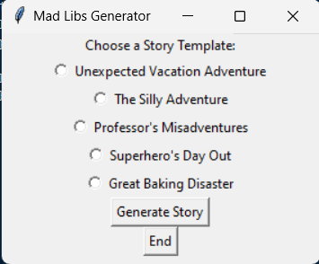
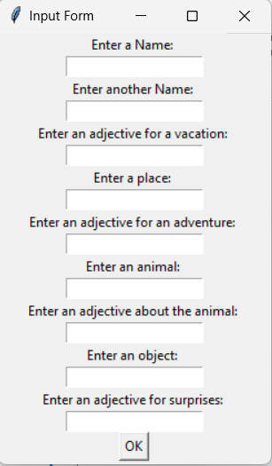
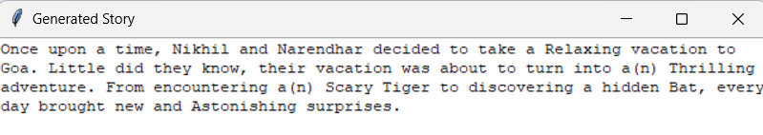
RESULTS AND DISCUSSION – SCREENSHOTS OF OUTPUTS
1.
2.
3.

Slide 8
LEARNING FROM THIS PROJECT
Tkinter Basics:
Introduction to Tkinter for GUI development in Python.
File Handling:
Reading files and handling exceptions, such as FileNotFoundError.
Class-Based Structure:
Organizing code using classes for modularity.
User Input Forms:
Creating an efficient user input form using Tkinter.
String Formatting:
Using string formatting to dynamically generate content based on user input.

Slide 9
CONCLUSION
GUI Fundamentals:
Practical exposure to Tkinter for building graphical user interfaces in Python.
File Handling Proficiency:
Skills in reading files and addressing errors, exemplified by handling FileNotFoundError.
Modular Code Organization:
Understanding the benefits of organizing code using classes for improved modularity.
User-Friendly Input Forms:
Implementation of an efficient user input form for a seamless experience.
Dynamic Content Generation:
Mastery of string formatting for dynamically generating content based on user input.

Slide 10
FUTURE WORK
Expand Templates:
Introduce more diverse story templates.
User-Defined Templates:
Allow users to create and save custom templates.
Visual Enhancements:
Improve aesthetics with images, styling, and themes.
Database Integration:
Implement a database for template management.
Randomize Feature:
Enable users to randomize the inputs instead of having to type them.

Slide 11
Thank You

